Slide 1
STAT 717: Lecture 1
Vitaly Druker
August 26, 2021

Slide 2
Introduction
What is Multivariate Data?

Slide 3
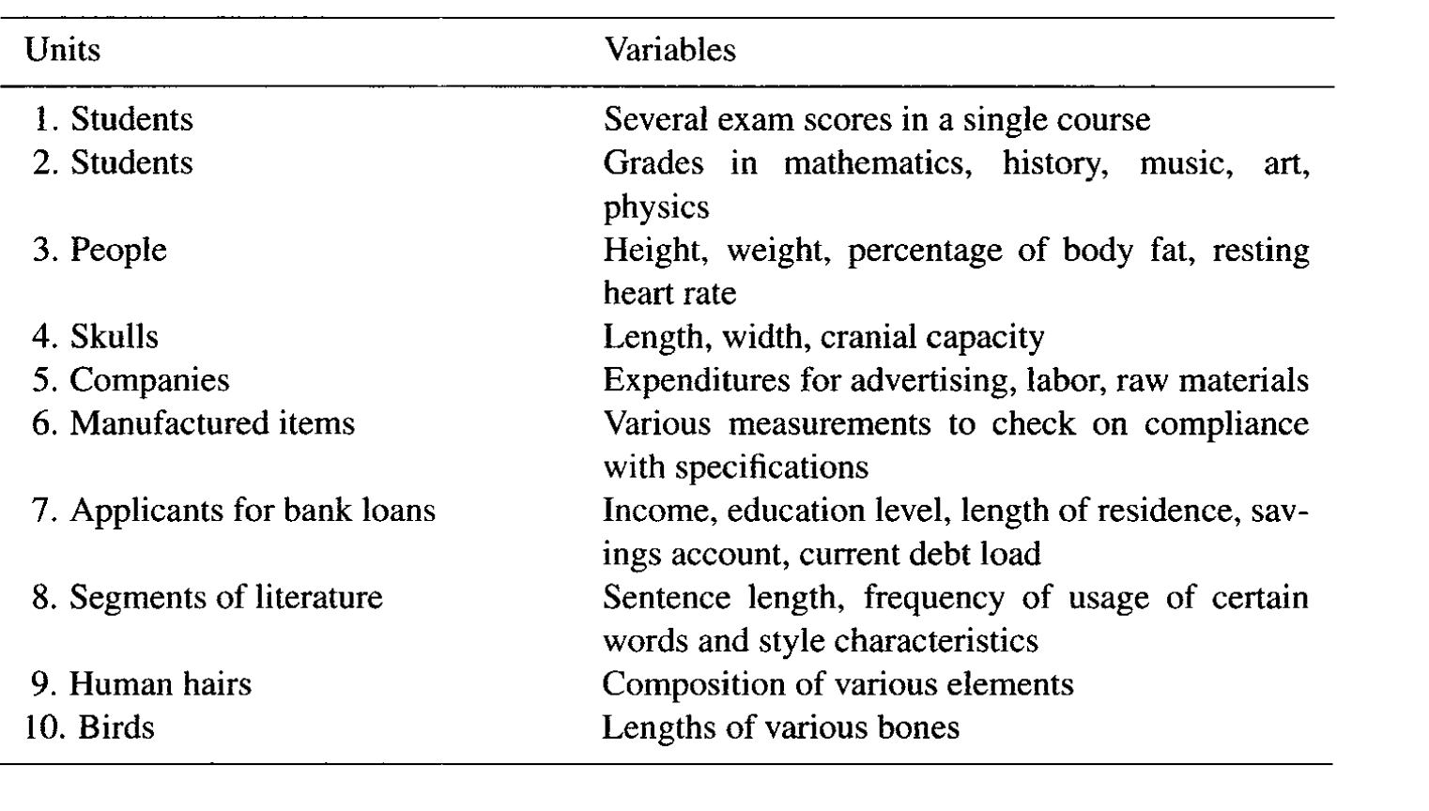
Notes:
The key is measurement

Slide 4
Introduction
Why do we want to do it?

Slide 5
Matrix Algebra

Slide 6
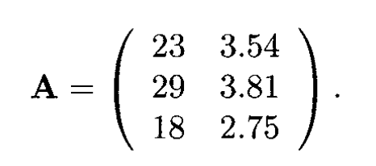
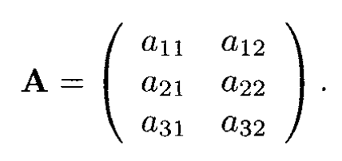
What is a matrix?
Rows: i
Columns: j
Uppercase boldface letters

Slide 7
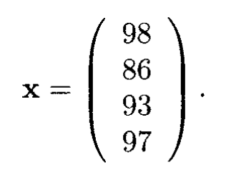
What is a vector?
We generally talk about column vectors.
Lowercase boldface letters are column vectors

Slide 8
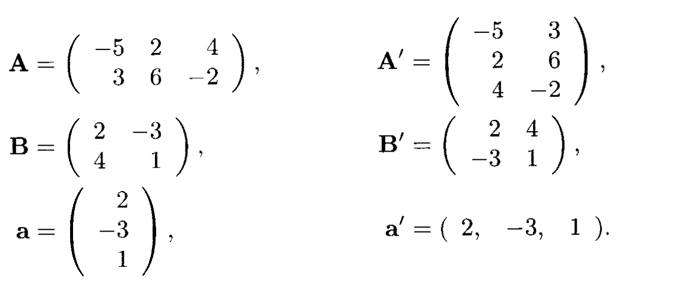
Operation: Transpose

Slide 9
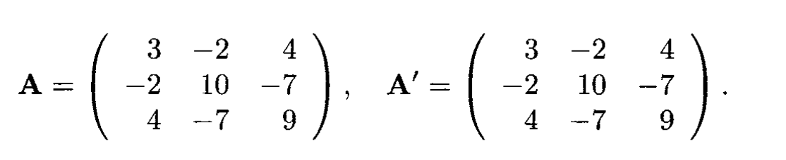
Property: Symmetric
The transpose of a matrix is the same as the original

Slide 10
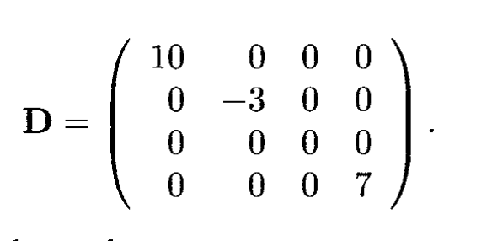
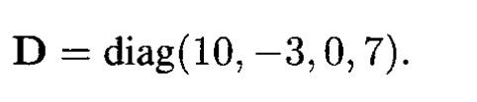
Property: Diagonal
A square matrix where all non-diagonal elements are 0

Slide 11
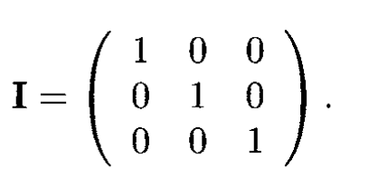
Property: Identity Matrix
A diagonal matrix where all the values on diagonal are 1

Slide 12
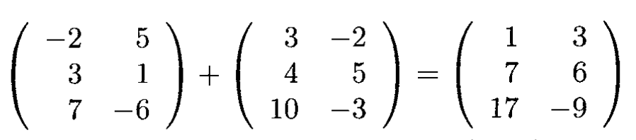
Operation: Addition/Subtraction
They must be the same size

Slide 13
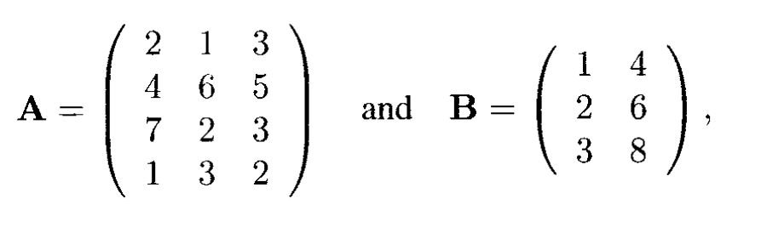
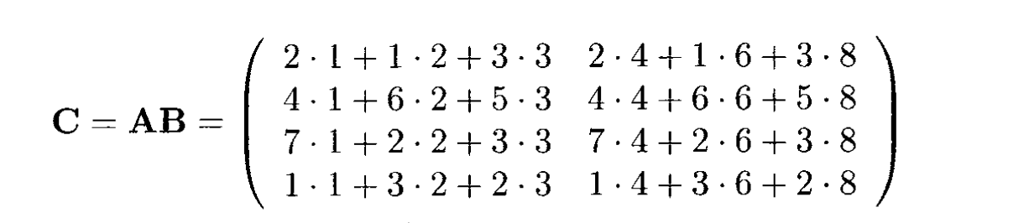
Operation: Multiplication
In order to be able multiply matrices AB the columns of A must equal the rows of B
(4,3) * (3,2) = (4, 2)

Slide 14
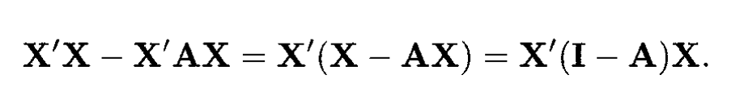
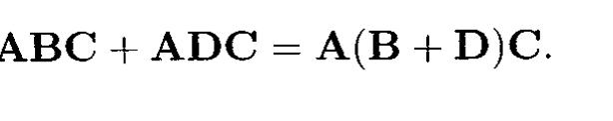
Multiplication: Factoring out values
Factor to the left and then to the right
XI = X

Slide 15
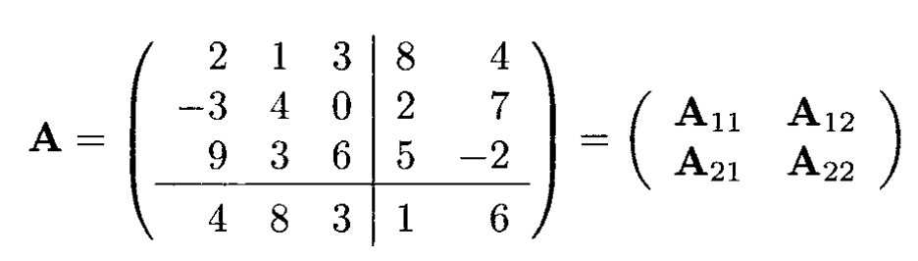
Convenience: Partitioning

Slide 16
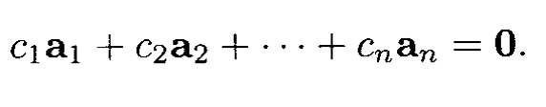
Property: Rank
Linear Dependence/Independence
If no (not all zero) can be found for the above then there is linear independence
Linear dependence suggests redundancy – note only LINEAR redundancy
If A is n x p then the max rank is the smaller of n and p

Slide 17
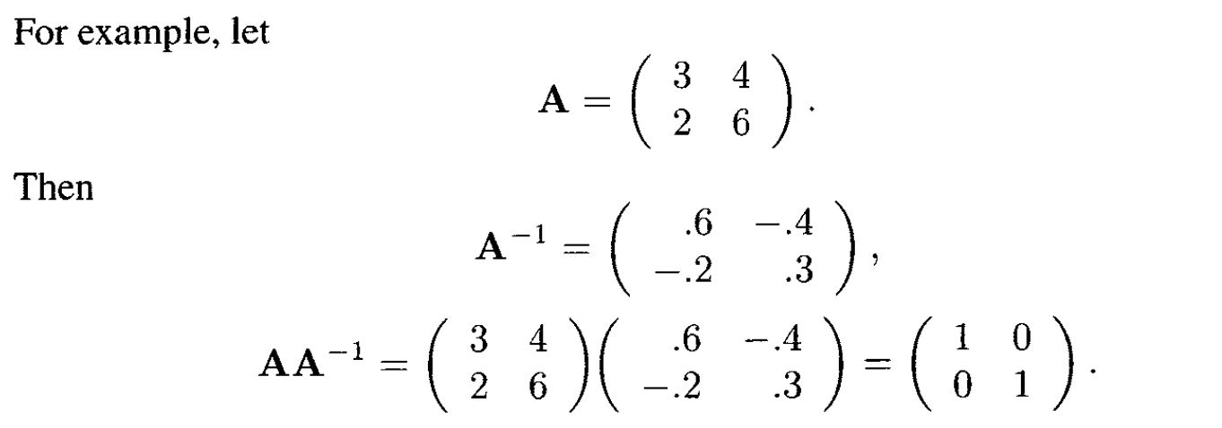
Operation: Inverse
Matrix A is square and full rank
A is nonsingular and has a unique inverse A⁻¹.

Slide 18
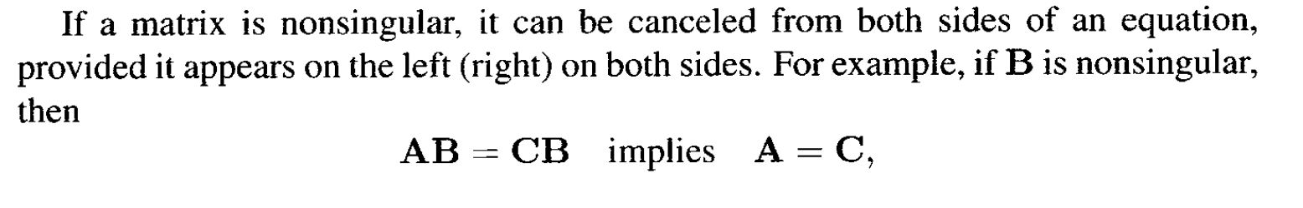
Operation Inverse – further properties

Slide 19


Property: Positive Definite
Symmetric matrix is positive definite if x’Ax > 0 for all vectors x (x not equal to 0)
Positive semidefinite if x’Ax >= 0
What is the dimension of x’Ax

Slide 20
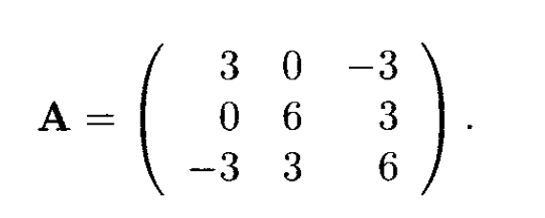
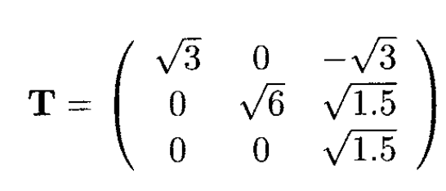
Positive Definite: Further Properties
If A is positive definite then A can be factored into T’T
One method is Cholesky decomposition

Slide 21
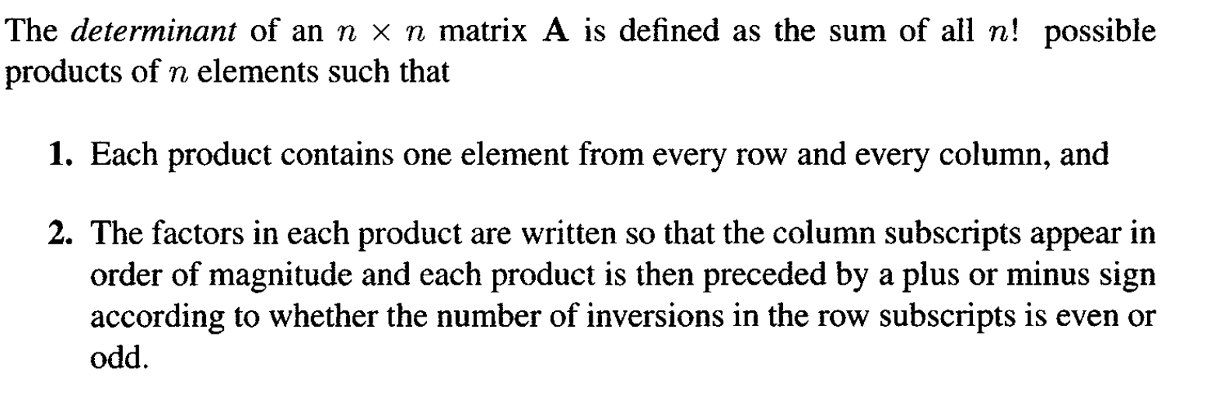
Property: Determinates

Slide 22
Determinates: Further Properties
Determinate of diagonal matrix is the product of the diagonal elements
Determinates of square singular matrix is 0
If A is positive definite then det(A) > 0
Determinate of transpose of matrix is = to regular determinate

Slide 23
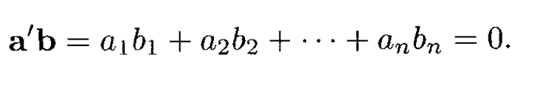
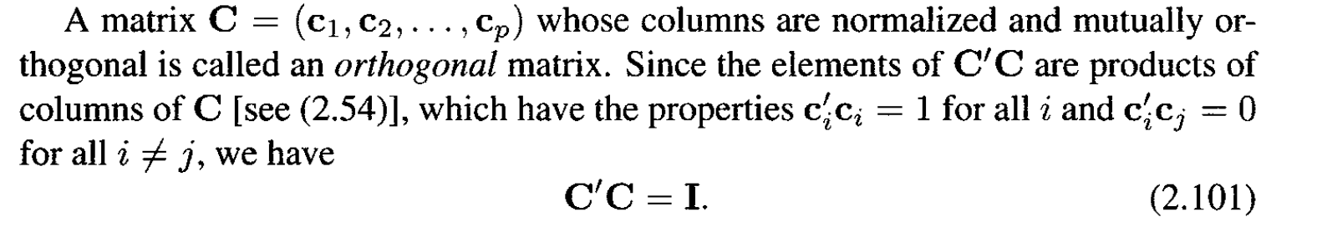
Property: Orthogonal
Two vectors a and b of the same size are said to be orthogonal if

Slide 24
Operation: Trace
Sum of diagonal elements of a matrix
tr(AB) = tr(BA).

Slide 25
Eigenvalues and Eigenvectors

Slide 26
Definition
For every square matrix A, a scaler λ and nonzero vector x.
Αx = λx
λ is an eigenvalue and x is an eigenvector
To solve:
(A - λI)x = 0.
Therefore we set the det to 0 to find λs then solve for x

Slide 27
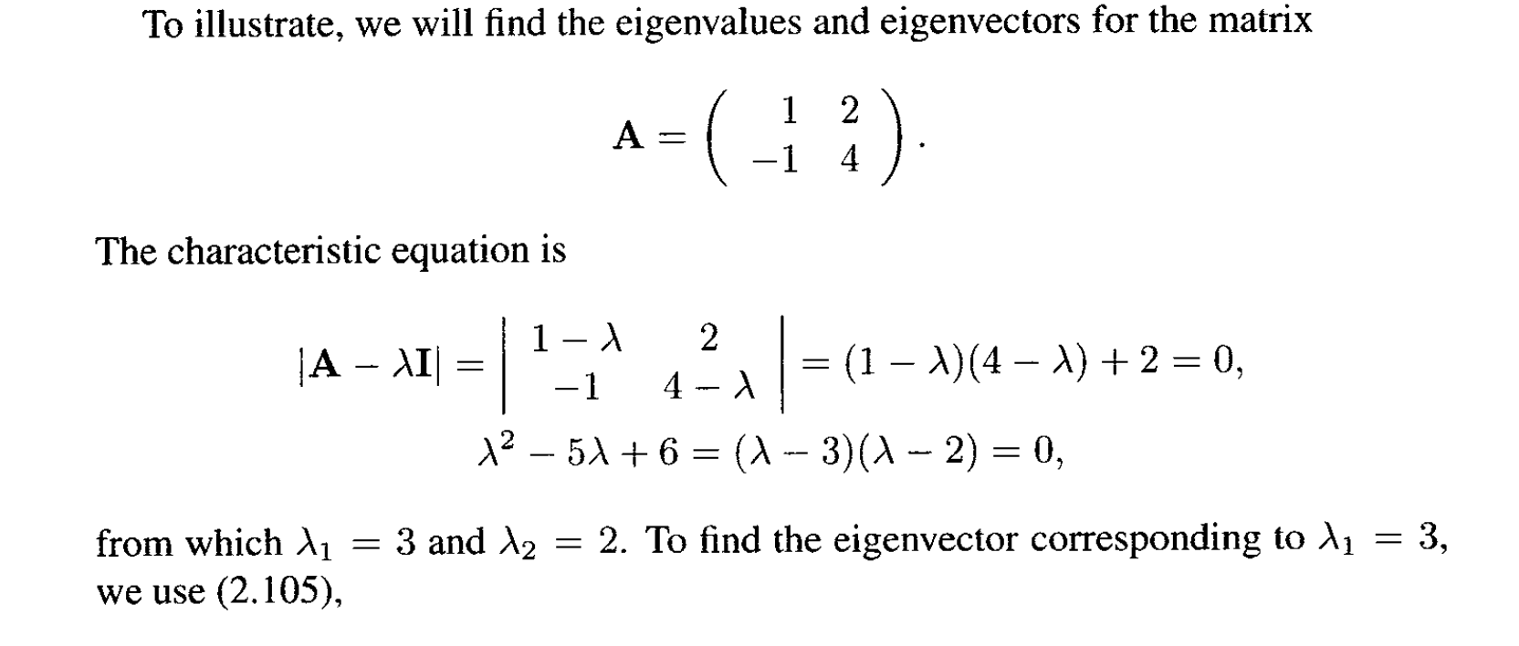
Example

Slide 28
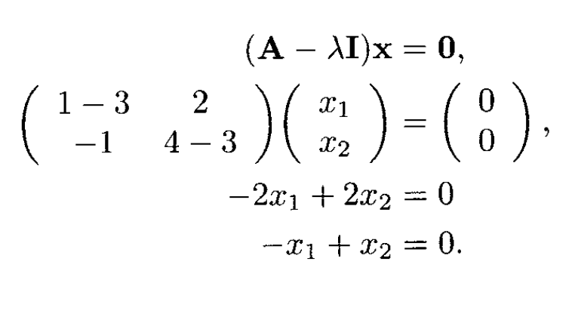
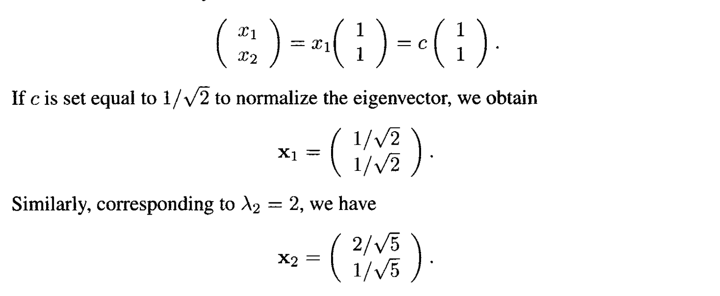
Example continued

Slide 29
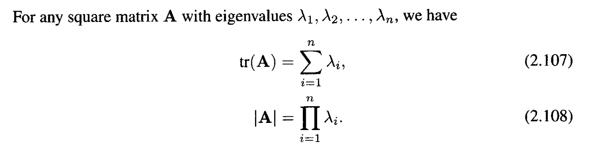
trace and determinate

Slide 30
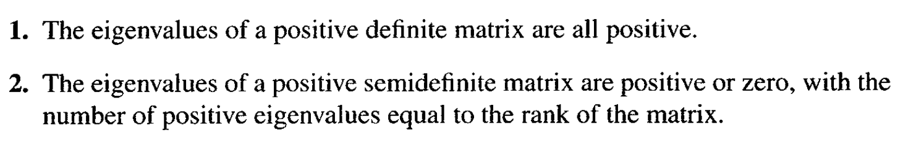
Positive Definite and Semidefinite Matrices

Slide 31
Homework
Due before class next week. I will add a place to upload in blackboard
Read Chapter 1 and 2
2.7
Additionally, show the result of all the combinations using R
2.26

